Slide 1

Malignant Comments Classifier
20th Sep,2022
Internship-27
Presented by:
Someshwar Dipak

Slide 2
Acknowledgement
Data Science with ML
SME – Khushboo Garg
Flip Robo Technology

Slide 3
Why Malignant Comments Classifier Prediction Need:
The proliferation of social media enables people to express their opinions widely online. However, at the same time, this has resulted in the emergence of conflict and hate, making online environments uninviting for users. Although researchers have found that hate is a problem across multiple platforms, there is a lack of models for online hate detection.
Online hate, described as abusive language, aggression, cyberbullying, hatefulness and many others has been identified as a major threat on online social media platforms. Social media platforms are the most prominent grounds for such toxic behaviour.
There has been a remarkable increase in the cases of cyberbullying and trolls on various social media platforms. Many celebrities and influences are facing backlashes from people and have to come across hateful and offensive comments. This can take a toll on anyone and affect them mentally leading to depression, mental illness, self-hatred and suicidal thoughts.

Slide 4
Internet comments are bastions of hatred and vitriol. While online anonymity has provided a new outlet for aggression and hate speech, machine learning can be used to fight it. The problem we sought to solve was the tagging of internet comments that are aggressive towards other users. This means that insults to third parties such as celebrities will be tagged as unoffensive, but “u are an idiot” is clearly offensive.
Our goal is to build a prototype of online hate and abuse comment classifier which can used to classify hate and offensive comments so that it can be controlled and restricted from spreading hatred and cyberbullying.

Slide 5
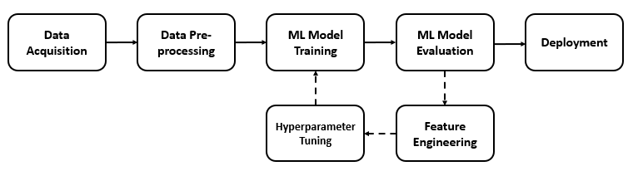
Malignant Comments Classifier Diagram:

Slide 6
Visualization of Malignant Comments Classifier

Slide 7
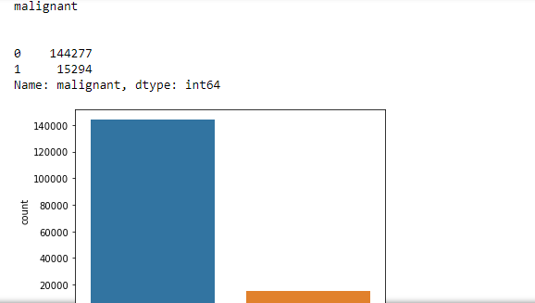
Graphs:
In above graph the count of non malignant is higher than malignant.

Slide 8
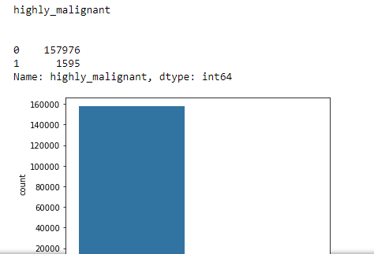

Graphs:
In above graph the count of non highly malignant is higher than highly malignant.

Slide 9
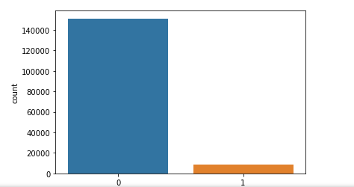
Graphs:
In above graph the count of non rude is higher than rude.

Slide 10
Graphs:
In above graph the count of non rude is higher than rude.

Slide 11
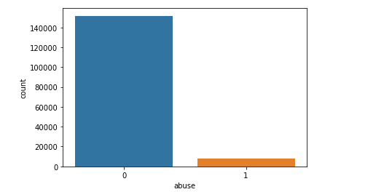
Graphs:
In above graph the count of non abuse is higher than abuse.

Slide 12
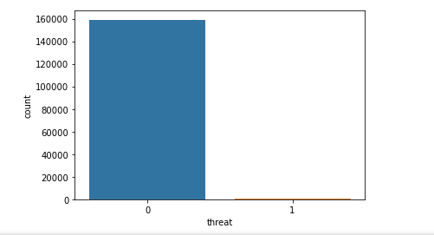
Graphs:
In above graph the count of non threat is higher than threat.

Slide 13
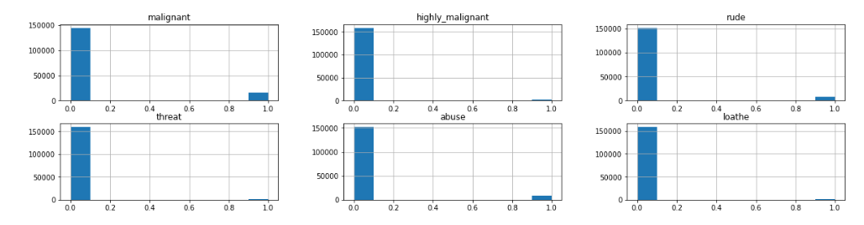
Graphs:

Slide 14
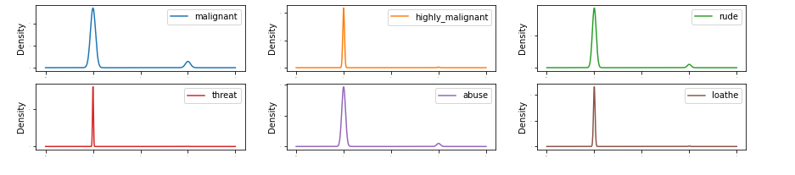
Graphs:

Slide 15
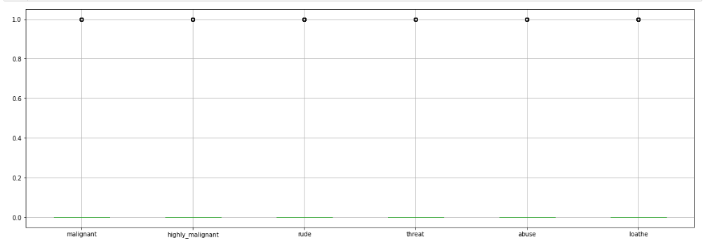
Graphs:

Slide 16
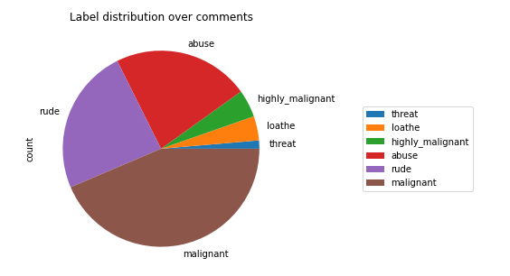
Graphs:

Slide 17
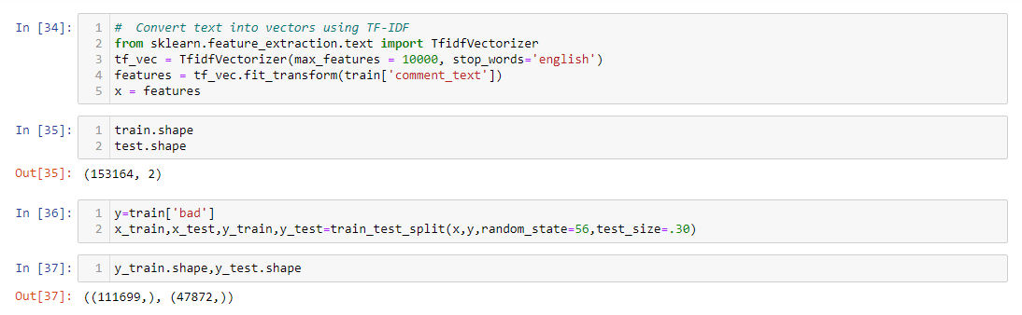
Model Building, Model Evaluation and Selecting the best model

Slide 18
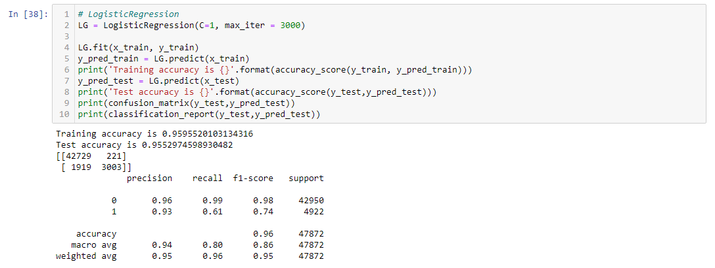
Model Building, Model Evaluation and Selecting the best model

Slide 19
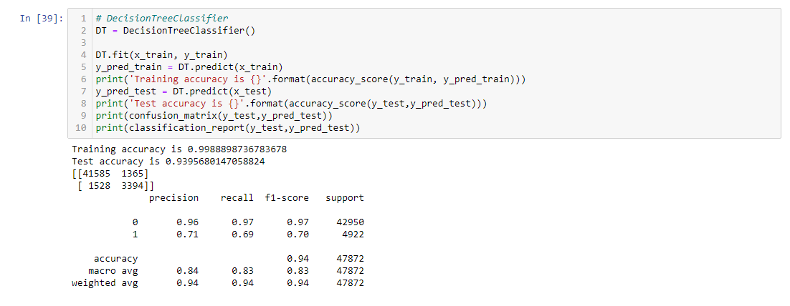
Model Building, Model Evaluation and Selecting the best model

Slide 20
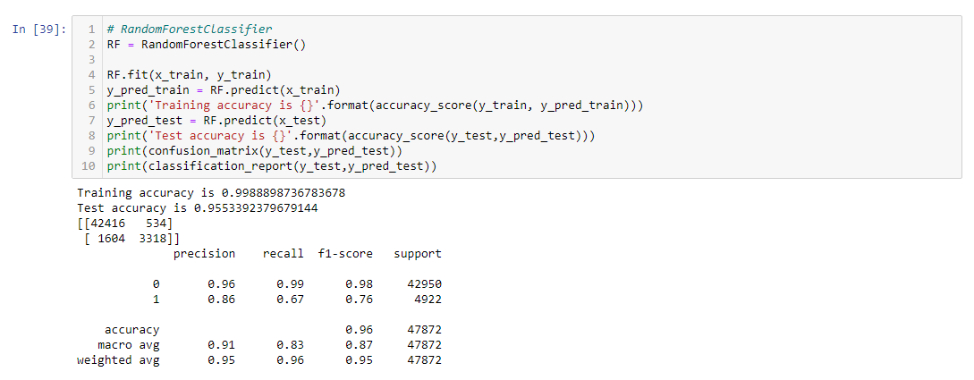
Model Building, Model Evaluation and Selecting the best model

Slide 21
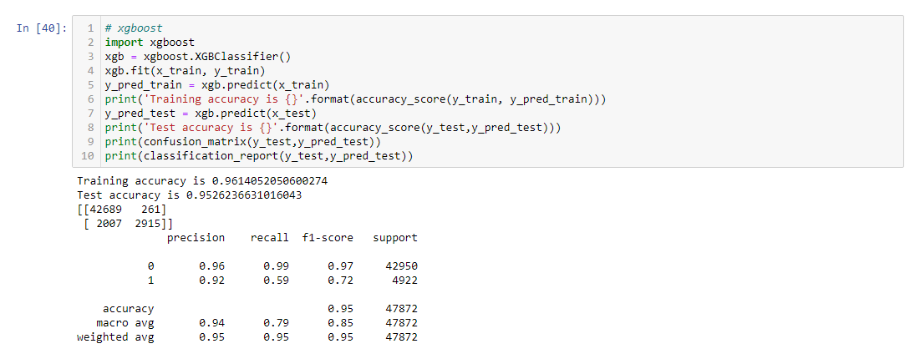
Model Building, Model Evaluation and Selecting the best model

Slide 22
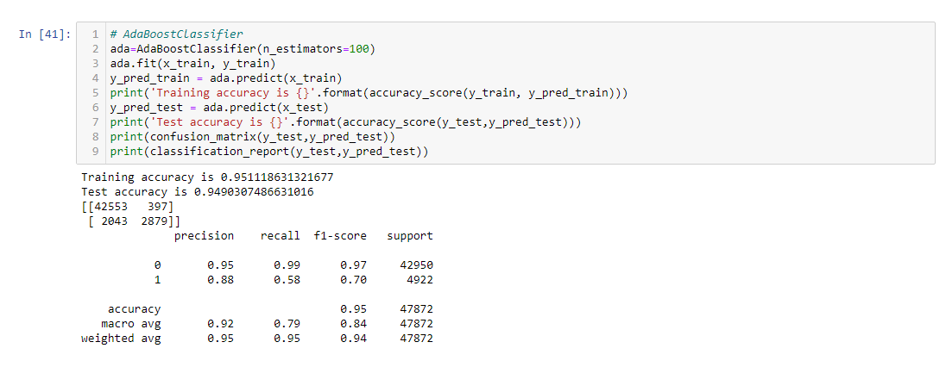
Model Building, Model Evaluation and Selecting the best model

Slide 23
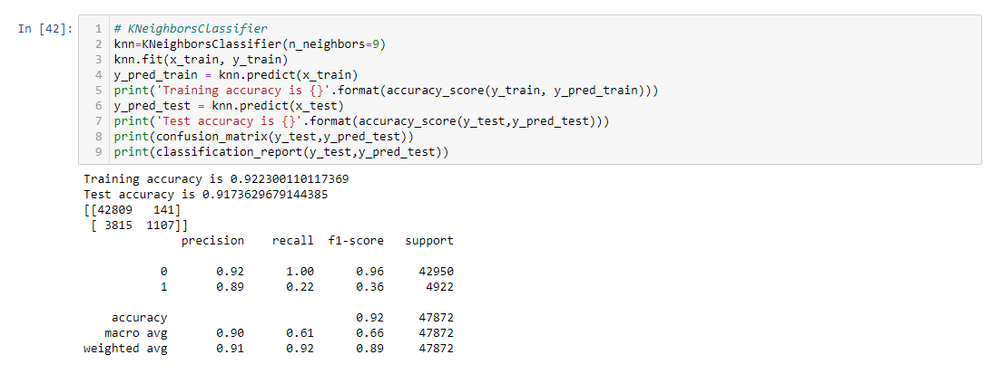
Model Building, Model Evaluation and Selecting the best model

Slide 24
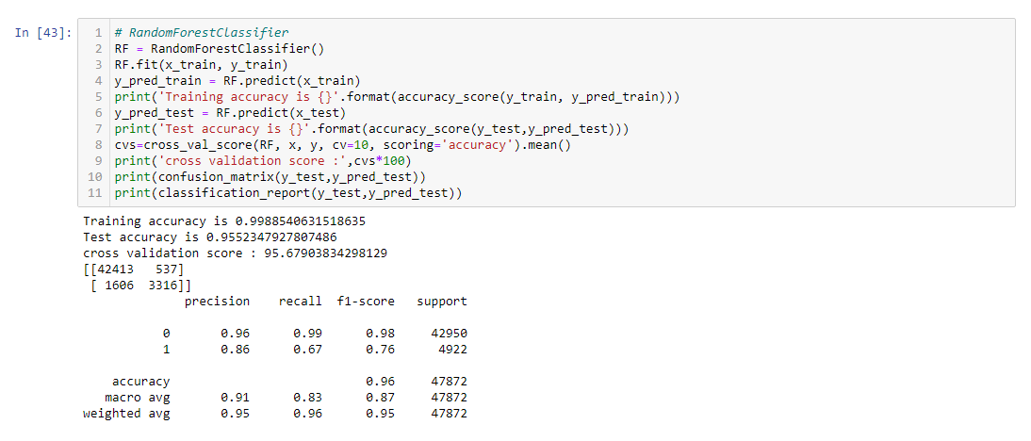
Model Building, Model Evaluation and Selecting the best model

Slide 25
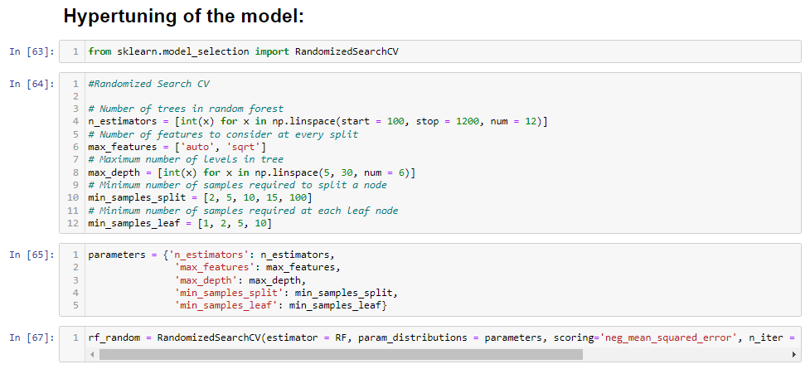
Hypertuning of the model:

Slide 26
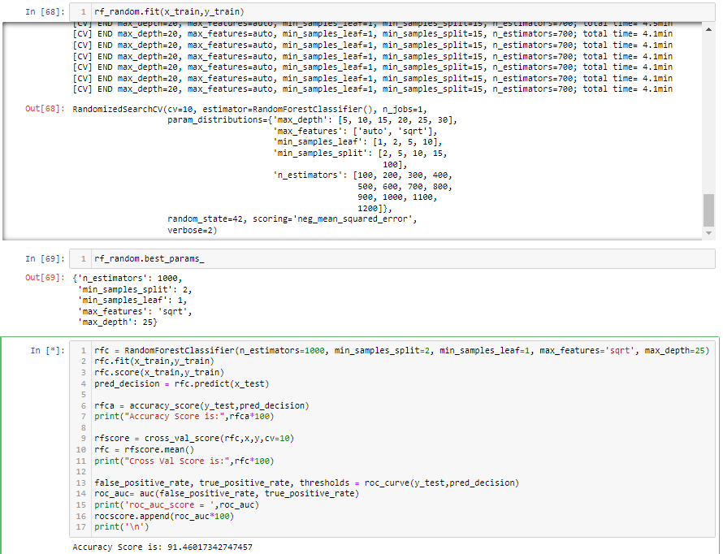
Hypertuning of the model:

Slide 27
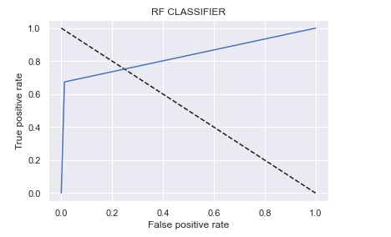
Display Auc-RoC curve:

Slide 28
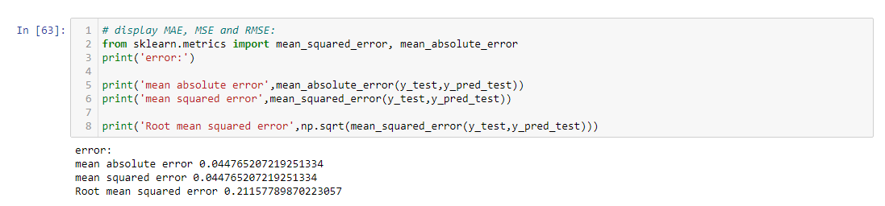
Display MAE, mse and rmse:

Slide 29
Model Saving:

Slide 30
Conclusion:
This Kernel investigates different models for car price prediction.
Different types of Machine Learning methods including LogisticRegression, RandomForestClassifier, KNeighborsClassifier, xgboost, AdaBoostClassifier and DecisionTreeClassifier in machine learning are compared and analysed for optimal solutions.
Even though all of those methods achieved desirable results, different models have their own pros and cons.
The RandomForestClassifier is probably the best one and has been selected for this problem.
Finally, the RandomForestClassifier is the best choice when parameterization is the top priority.

